Slide 1


FORECASTING GLOBAL SUPERSTORE SALES
Team1:
Kanchan Sharma
Geethasree Madiraju Nagaraju
pothineni Lahari priya
Zhexin Zhang
Roshita Seelam

Slide 2


AGENDA & BUSINESS CASE
PROJECT SUMMARY
BUSINESS CASE
WHAT ARE WE FORECASTING?
1.
DATA PREPARATION
SALES OF GLOBAL SUPERSTORE FOR THE UPCOMING MONTHS
2.
DATA EXPLORATION
WHO DOES THIS FORECAST BENEFIT?
3.
MODEL COMPARISON
THE FOLLOWING TEAMS OF GLOBAL SUPERSTORE:
SALES AND MARKETING TEAM
INVENTORY AND SUPPLY CHAIN MANAGEMENT
STAKEHOLDERS AND INVESTORS
4.
MODEL SELECTION

Slide 3

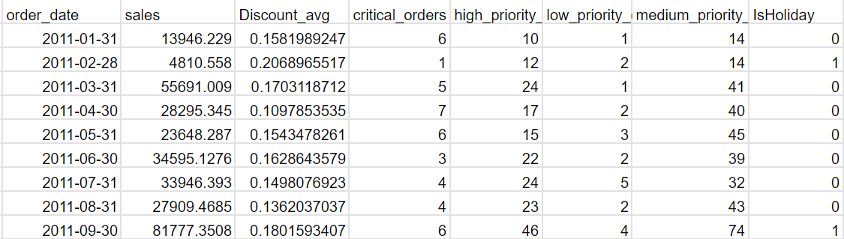


DATA PREPARATION
DATA SET (https://www.kaggle.com/datasets/shekpaul/global-superstore?resource=download)
DATA ACCUMULATED IN A MONTHLY ORDER.
COLUMNS CHOSEN
TARGET VARIABLE: SALES
TIME VARIABLE: ORDER_DATE
INDEPENDENT VARIABLE: HOLIDAY, DISCOUNT_AVG
NO MISSING VALUES

Slide 4


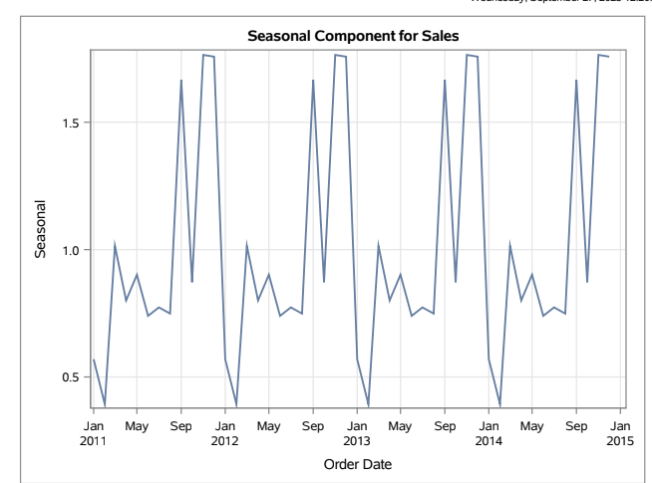
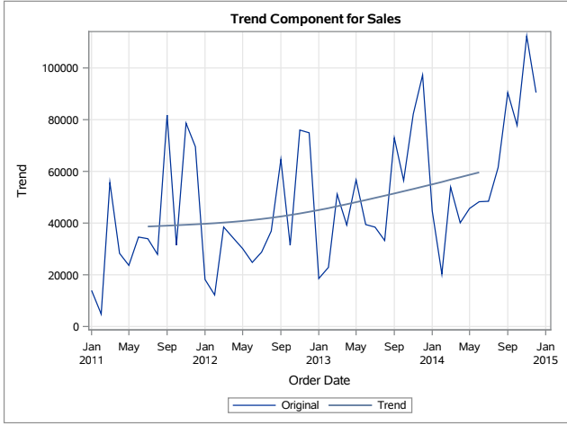
DATA EXPLORATION
SEASONALITY
TREND

Slide 5


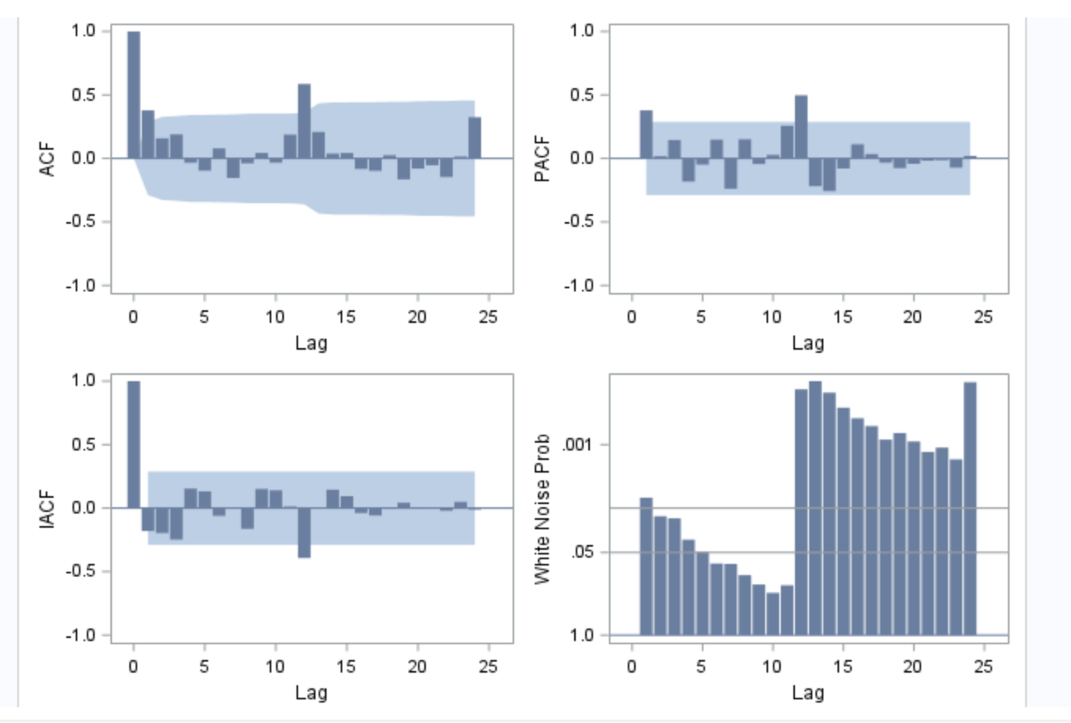
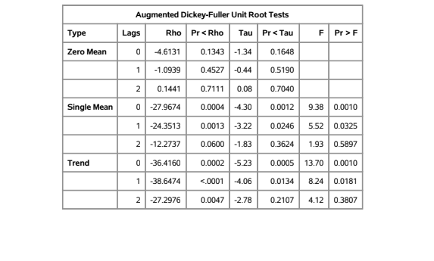
DATA EXPLORATION
CORRELATION ANALYSIS
ADF TEST
SIGNIFICANT CORRELATION at lag 0, 12 FOUND NO SIGNIFICANT WHITE NOISE
CONCLUSION: SERIES CAN BE MODELED, considering seasonality
STATIONARY SERIES

Slide 6
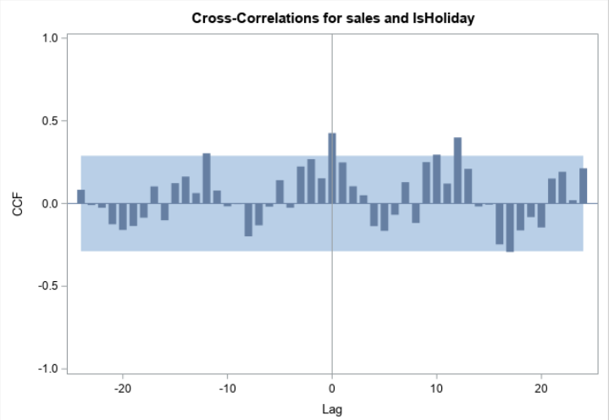
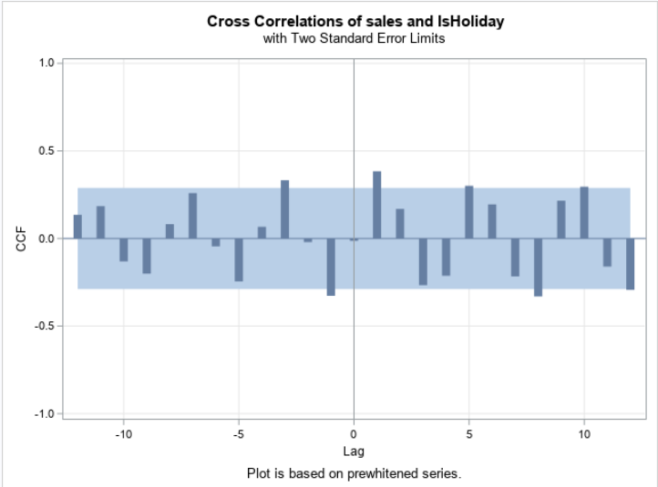
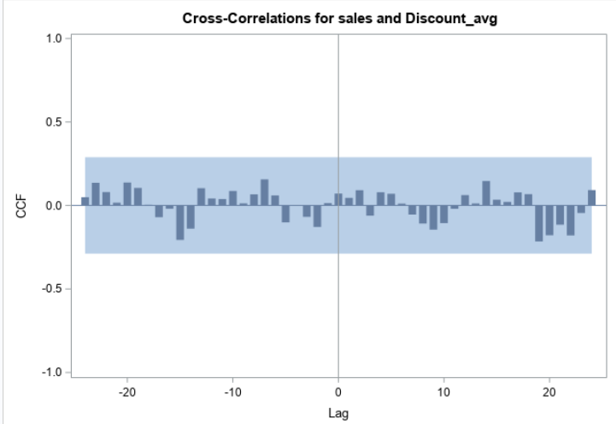
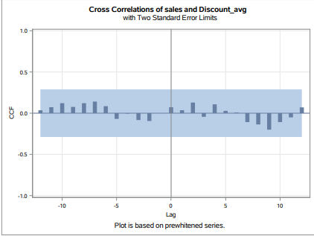
CROSS CORRELATION & PREWHITENING
HOLIDAY AS INDEPENDENT VARIABLE
DISCOUNT AS INDEPENDENT VARIABLE

Slide 7

MODEL COMPARISON
Winters Additive
AIC: 225.537
SBC: 225.537
MAPE: 16.1345
MAE: 9373.21
SARIMAX(isHoliday)
AIC: 771.50
SBC: 777.72
MAPE: 18.39
MAE: 7838.41
SARIMA
AIC: 1038.6
SBC: 1044.15
MAPE: 29.2295
MAE: 11673

Slide 8
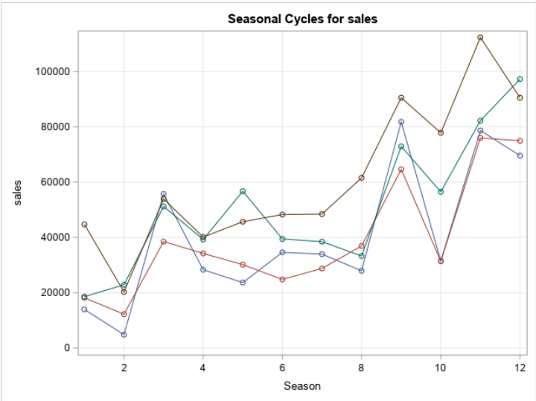
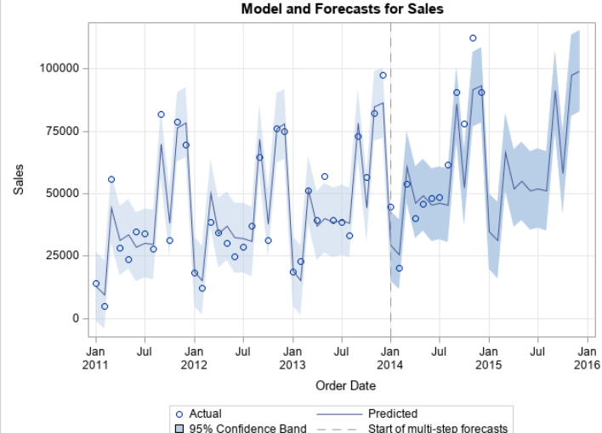
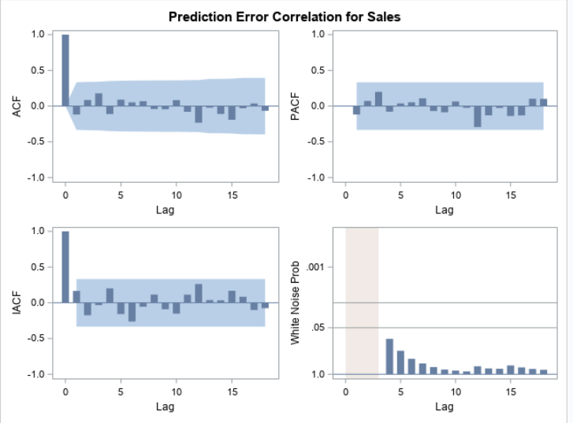

BEST MODEL-WINTERS ADDITIVE
WINTERS ADDITIVE
8

Slide 9


BUSINESS INSIGHTS & RECOMMENDATIONS
BUSINESS INSIGHTS
BUSINESS RECOMMENDATIONS
THERE’S A CONSTANT DIP IN SALES AROUND THE MONTH OF FEBRUARY
AND A CONSTANT SPIKE AROUND THE MONTH OF DECEMBER
THE OVERALL SALE OVER THE NEXT 12 MONTHS SEEMS SIGNIFICANTLY HIGHER THAN THE LAST 48 MONTHS INDICATING A GROWTH IN BUSINESS.
OPTIMIZING INVENTORY
MARKETING STRATEGY
INVESTMENT AND EXPANSION

Slide 10




THANK YOU
&
QUESTIONS?

